Slide 1
GASTROINTESTINAL TRACT OVERVIEW
NDONGA KENNEDY

Slide 2
ANATOMIC AND PHYSIOLOGIC OVERVIEW
The Gastro-Intestinal tract is 23-26 foot-long pathway and extends from the mouth to the esophagus, stomach, small intestines and rectum, to the terminal structure the anus. Accessory organs include; teeth and gums, tongue, salivary glands, the liver, gall bladder and the pancreas.
The mouth: contains the tongue and teeth which help in chewing and swallowing of food and salivary glands that aid in digestion.
The esophagus is located in the mediastinum anterior to the spine and posterior to the trachea and heart. It is approximately 25cm in length and passes through the diaphragm at the diaphragmatic hiatus.

Slide 3
ANATOMIC AND PHYSIOLOGIC OVERVIEW cont’d
The stomach is located in the left upper portion of the abdomen under the left lobe of the liver and diaphragm, overlaying most of the pancreas. It has four anatomical regions: the cardia, fundus, body and pylorus.
The small intestine is the longest segment of the GI tract accounting for 2/3^{rds} of the total length. It has three sections : the duodenum, jejunum and ileum.
The large intestines consist of an ascending segment to the right side of the abdomen, a transverse segment that extends form the right to left side of the abdomen, and a descending segment on the left. Completing the terminal portion of the large intestine are sigmoid colon, the rectum and the anus

Slide 4
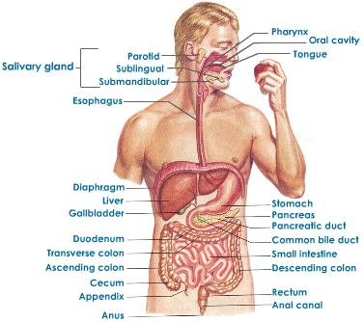
Anatomy of the digestive system

Slide 5
Functions of the digestive system cont’d
Primary functions of the GI tract are:
Breakdown of food particles into the molecular form for digestion
Absorption into blood stream of the small nutrient molecules produced by digestion
The elimination of undigested unabsorbed food stuffs and other waste products
Chewing and swallowing
Digestion begins with the act of chewing in which food is broken down into small particles that can be swallowed and mixed with digestive enzymes.
Approx 1.5L of saliva is secreted daily from the salivary glands.

Slide 6
Functions of the digestive system
Ptyalin enzyme in the saliva commences the digestion of starches.
Swallowing begins as a voluntary act that is regulated by the swallowing center in the medulla oblangata. Food is propelled down the GI tract by peristalsis
Gastric function
The stomach stores and mixes food with secretions.
Gastric secretions aid in breakdown of food into absorbable components and help in destruction of most ingested bacteria.

Slide 7
Functions of the digestive system cont’d
Gastric function cont’d..
Pepsin enzyme is important for protein digestion.
Intrinsic factor also secreted by the gastric mucosa, combines dietary Vit. B12 so that it can be absorbed in the ileum
Small intestine function
Digestive process continues in the duodenum. Duodenal secretions come from the accessory digestive organs- the pancreas(trypsin, amylase &lipase), liver and gall bladder(Bile) and the glands in the wall of the intestines.

Slide 8
Functions of the digestive system cont’d
Small intestine function cont’d…
Small finger like projections-villi- are present through out the entire intestine and function to produce digestive enzymes as well as absorb nutrients.
The process of absorption begins in the jejunum and is accomplished by both active transport and diffusion across the intestinal wall into the circulation.
Colonic function
Bacteria in the colon assist in completing the breakdown of waste material (undigested or unabsorbed proteins and bile salts)

Slide 9
Functions of the digestive system cont’d
Colonic function cont
There are two types of colonic secretions; electrolyte solution and mucus.
Electrolyte solution is chiefly bicarbonate solution that acts to neutralize the end products formed by the colonic bacterial action.
Mucus protects the mucosa from interluminal contents and provides adherence for the fecal matter
Waste products of digestion
Fecal matter is about 75% fluid and 25% solid material
The composition is relatively unaffected by alterations in diet because a large proportion of the fecal matter is of non dietary origin, derived from secretions of the GI tract.
Notes:
Accessory organs of digestion
Liver: it is the largest glandular organ in the body. The cells of the liver produce bile that is necessary for the emulsification of fats.
The liver releases 500-1000ml of bile per day. The bile travels through hepatic ducts to the gall bladder where it is stored.
Pancreas: it is an elongated gland that lies posterior to the stomach and is involved in both endocrine and exocrine duties.
each day the pancrease produces 1000-1500ml of pancreatic juice to aid in digestion. Pancreatic juices contain digestive enzymes protease(trypsin), lipase(steapsin) and amylase( amylopsin).

Slide 10
ASSESSMENT OF THE DIGESTIVE SYSTEM
It includes:
History and clinical manifestation
Physical assessment
Diagnostic evaluation

Slide 11
History and clinical manifestation
A focused GI assessment begins with a complete history. Information about abdominal pain, dyspepsia, gas, nausea and vomiting, diarrhea, constipation, feacal incontinence, jaundice and previous GI disease is investigated.
Pain
The character, duration, pattern, frequency, location, distribution of referred pain and time of pain vary and depend on underlying cause.
Dyspepsia( upper abdominal discomfort)
It is associated with indigestion. Fatty foods cause the most discomfort because they remain in the stomach for digestion longer than proteins and carbohydrates.

Slide 12
History and clinical manifestation cont’d
Intestinal gas
Patient will complain of bloating, distension or felling “full of gas” with excessive flatulence as a symptom of food intolerance or gall bladder disease.
Nausea and vomiting
Nausea is a vague unsettling sensation of sickness that may be followed by vomiting
Vomitus vary in color and content and may contain undigested food particles, blood or mucus
Change in bowel habit and stool characteristic
Nurse should inquire about constipation, diarrhoea and stool color and composition.

Slide 13
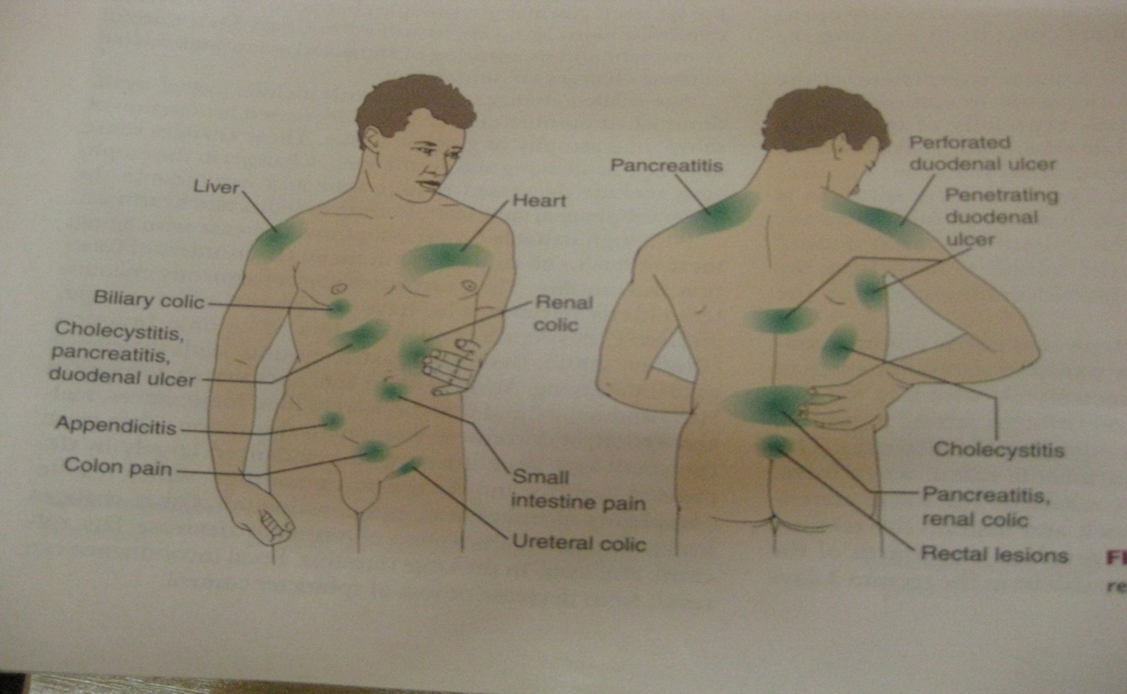
Referred pain

Slide 14
Physical assessment
It includes assessment of the mouth, abdomen and rectum and requires a good source of light.
The mouth, tongue, buccal mucosa, teeth and gums are inspected, noting ulcers, nodules, discoloration or inflammation.
Patient lies supine with knees flexed slightly for inspection, auscultation and percussion.
For purpose of examination and documentation, the abdomen can be divided into four quadrants or nine regions

Slide 15
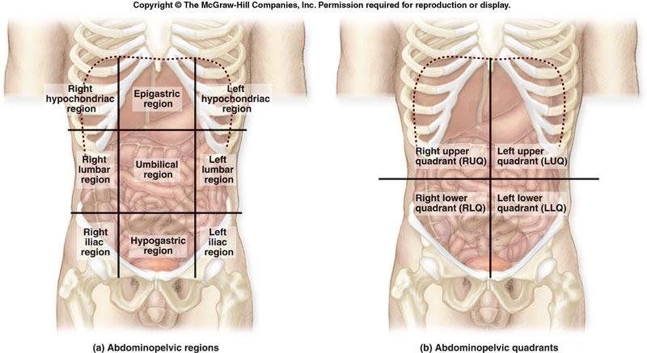
Division of the abdomen for examination

Slide 16
Physical assessment cont’d
Inspection of the abdomen
The nurse notes for:
Skin changes, nodules, lesions, scarring, discoloration, inflammation, bruising or striae.
Contour and symmetry of the abdomen. Localized bulging, distension or peristaltic waves are identified.
Expected contours of the anterior abdominal wall can be described as flat, rounded or scaphoid.

Slide 17
Physical assessment cont’d
Palpation of the abdomen
Light palpation is appropriate for identifying areas of tenderness or muscular resistance.
Deep palpation is used to identify masses
Percussion of the abdomen
It assess the size and density of the abdominal organs to detect the presence of air filled, fluid filled or solid masses
All quadrants are percussed for a sense of tympani( the predominant sound that results from the presence of air in the stomach and small intestine) and dullness( heard over organs and solid masses)

Slide 18
Physical assessment cont’d
Auscultation
It determines the character, location and frequency of bowel sounds and identifies vascular sounds
Bowel sounds are assessed in all four quadrants using the diaphragm of the stethoscope.
Rectum and anal canal are inspected digital. Positions for rectal examination include knee-chest, left lateral with hips and knees flexed or standing with hips flexed and upper body supported by the examination table.

Slide 19
Diagnostic evaluation
Some of the diagnostic tests done include:
Stool tests
Breathe tests
Abdominal ultra sound
Endoscopy
Laparoscopy
Imaging studies

Slide 20
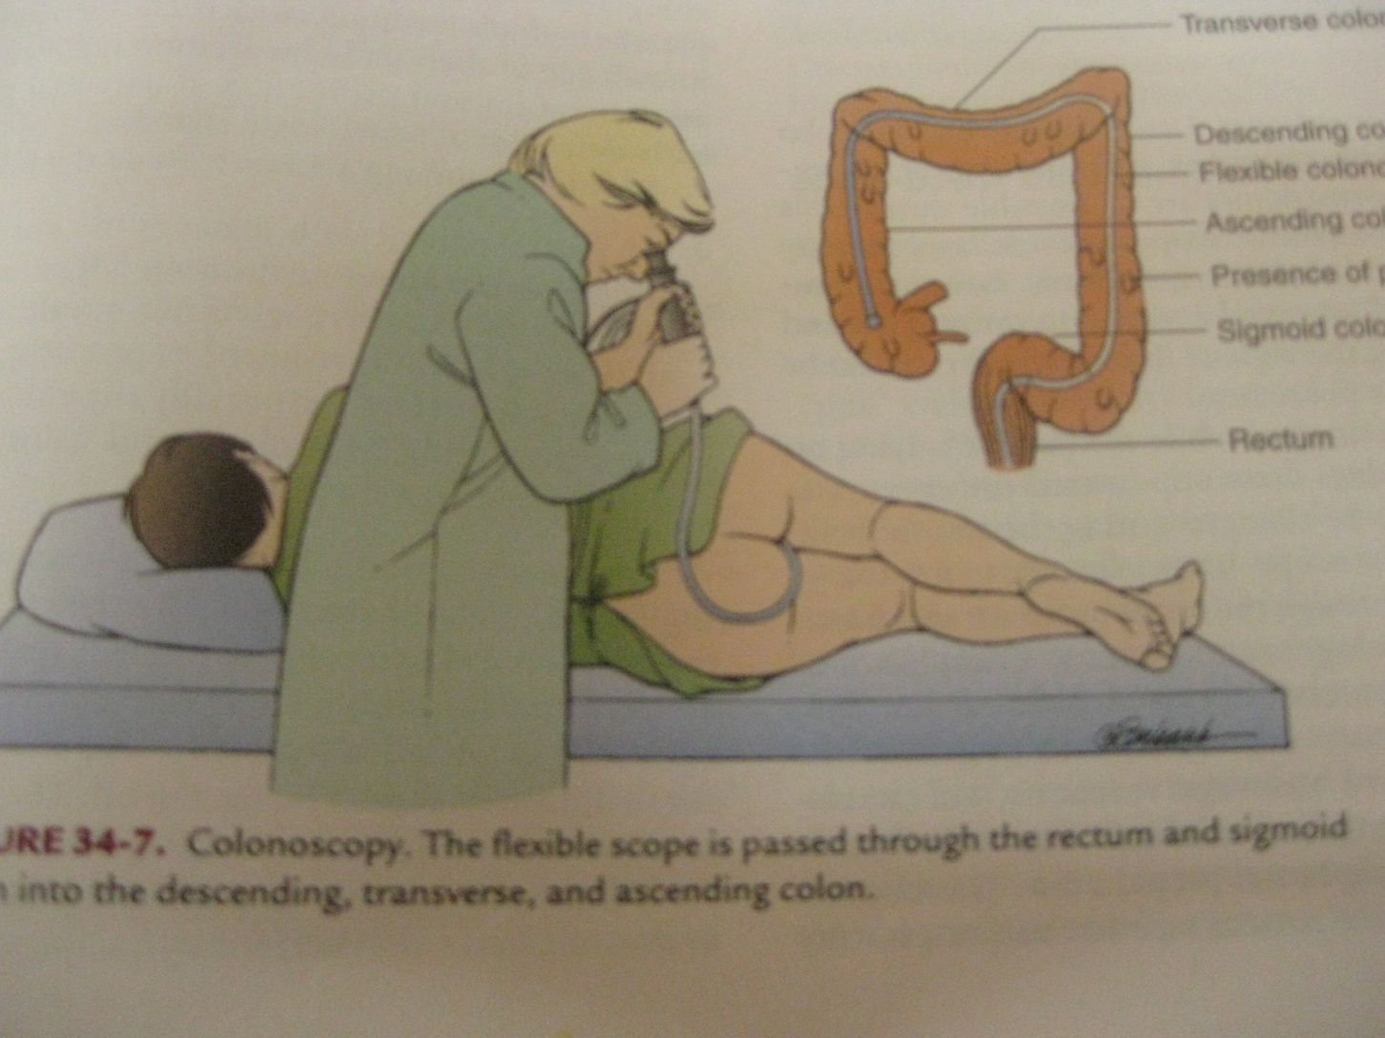
Colonoscopy

Slide 21
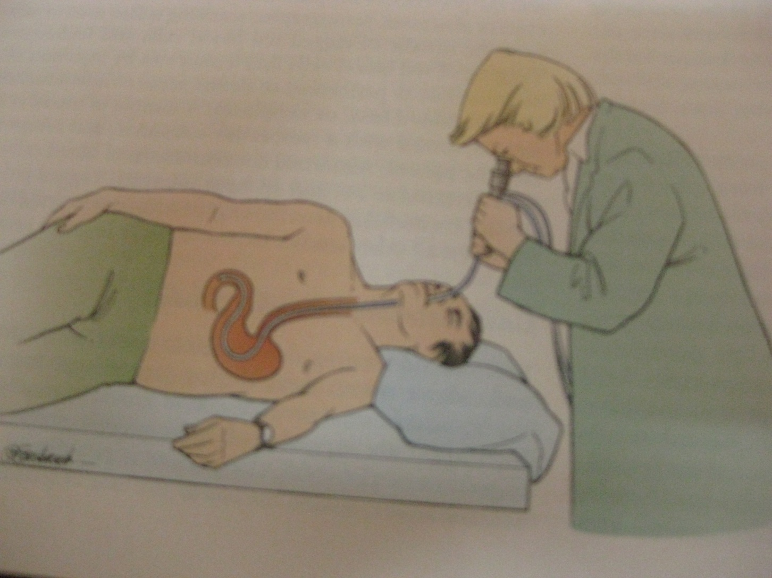
Endoscopy

